Slide 1
White Privilege Unmasked
Presentation Unitatian Annual Meetings
Dr. Judy Ryde
Member of Bath Unitarian Fellowship
Director: Trauma Foundation South West
Notes:
Welcome. Put in chat box their name, where they are from and any questions you come with

Slide 2
What we will cover today
A little of history of whiteness as a racial idea
More awareness of the privilege that white people carry
How we might address diversity and white awareness in ourselves and in our congregational communities
Notes:
How oftend do you think about race? Write in the text box. Peter to give answers

Slide 3
What does ‘white’ mean?
“How often do you talk about race with your family and friends? Daily, once a week, once a month, a couple times a year, never? I went back and forth between ‘once a month’ and ‘a couple times a year,’ thinking, who talks about race daily? All of the students of color answered ‘daily.’ I couldn’t believe it. I couldn’t even fathom what there would be to talk about every day. I didn’t yet understand that not talking about race was a privilege available only to white people. (Waking up White by Debbie Irving, 2014)"
How often do you think about race?
Notes:
In my book I look more closely at the history of the word white but I am using it here to mean the European diaspora which includes America, Australia, Canada etc
Raloph Wa;do emerson was an eminent Untiarian as some of you will know and inspite of being thought of as liberal minded – he advocated putting an end to slavery – he espoused what today would be abhorrent vies,

Slide 4
‘History doesn't excuse us, but it explains the conditions in which the interpretive process is occurring: what concepts I have at my disposal, how I am positioned vis- à- vis the “deep rules” of my milieu, and, most importantly, what of my own history is at stake as I try to make sense of new events.’
Linda Martin Alcoff, The Future of Whiteness 2015
Why is it important to look at History

Slide 5
‘Cheddar man’ reminding us that those who lived in Britain were not always white!
‘CHEDDAR MAN’

Slide 6
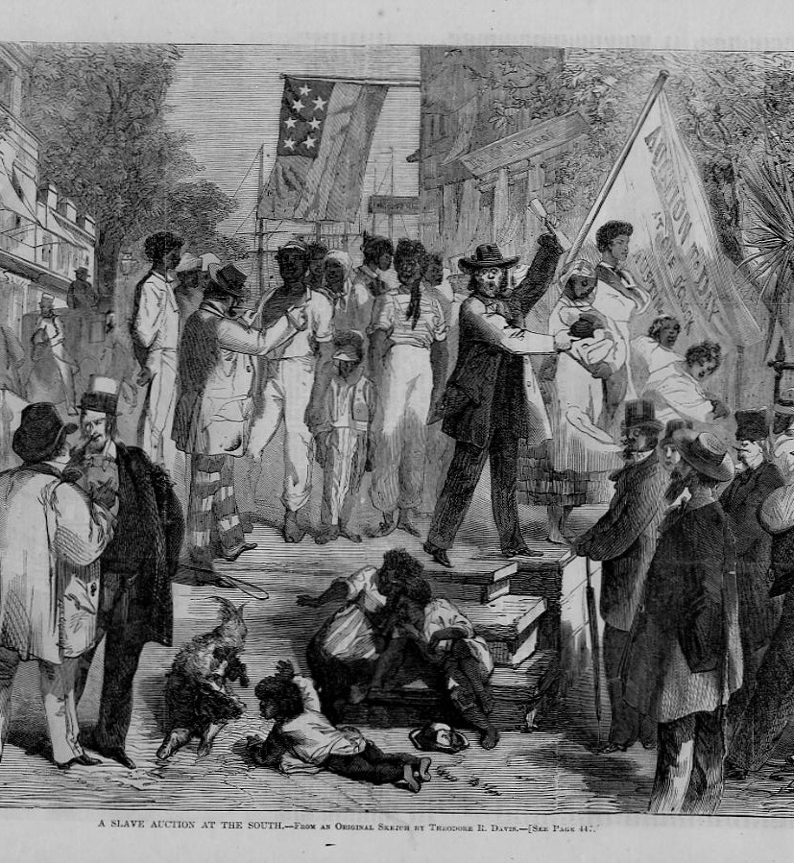
Colonisation, which started in the fifteenth century, led to the iniquitous slave trade which started in late 16th century and did not end until the early 19th century. We are still benefitting from this lucrative trade.

Slide 7
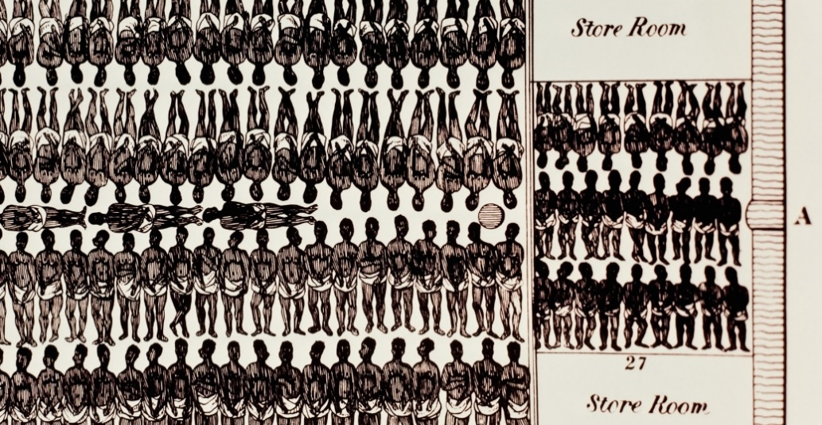
A diagramme of how slaves should be carried in shios like cargo.

Slide 8
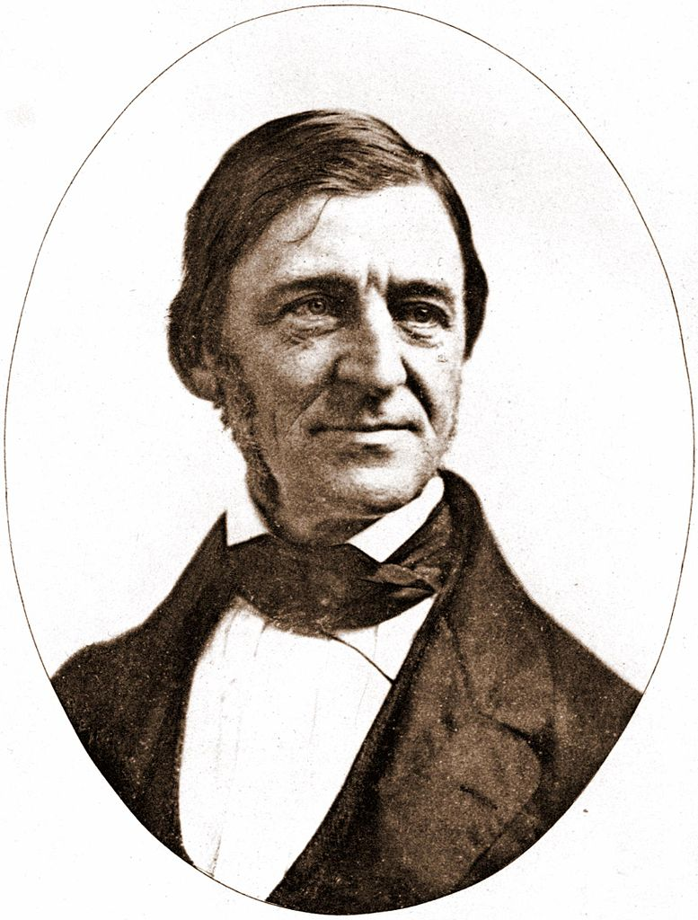
In 1850, Emerson, a famous Unitarian and
Dean of Harvard University, wrote in his
diary that ‘the black man’:
‘is created on a lower plane than the white, and eats men and kidnaps and tortures if he can. The Negro is reactionary merely in his successes and there is no origination with him in mental and moral sphere’
Emerson regarded himself as a ‘double distilled Englishman’ and said immigration to the USA should be restricted to ‘Anglo Saxons.’
Ralph Waldo Emerson

Slide 9
Francis Amasa Walker, an economist, statistician, journalist, educator and military officer said:
‘There is no reason why every foul and stagnant pool of population in Europe, which no breath of intellectual or industrial life has stirred for ages, should not be decanted upon our soil. Hard times here may momentarily check the flow; but it will not be permanently stopped so long as any difference of economic level exists between our population and that of the most degraded communities abroad’
(Walker, 1896:822)

Slide 10
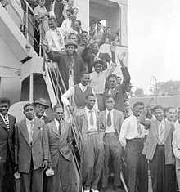
Immigrants arriving in Britain on the Windrush
They were greeted with
‘No Blacks, no Irish, no Dogs.’
It led to Enoch Powell’s ‘Rivers of blood’ speech, warning against immigration: ‘As I look ahead, I am filled with foreboding; like the Roman, I seem to see the River Tiber foaming with much blood.’

Slide 11
Some of the Measures to Try to Curb Racism
Civil rights movement began in America in the 1950s working towards anti racism legislation in 1964.
The Race Relations Act in Britain became law in 1965 which banned ‘discrimination on the grounds of colour, race or ethnic or national origins’ in public places.
In 1968 it was strengthened to include employment and housing.
Black Lives Matter – international activist movement 2013.

Slide 12
Institutional Racism
The murder of Stephen Lawrence in 1993 showed police did not give the crime much attention and were declared ‘institutionally racist’ in the Macpherson Report that followed in 1999.

Slide 13
‘Stop and search’ by police is 8 times more likely to target black people in spite of laws banning racial discrimination.
STOP AND SEARCH

Slide 14
So in what ways are white people privileged?
White privilege

Slide 15
Being ‘Just Normal’;
Building on past wealth;
The building of Britain’s ‘Great Houses and Cities’;
Here are some ways in which we still benefit
The supremacy of the English language;
Style of dress;
Globalisation of ‘White Culture’ including, for example, white sport;

Slide 16
If you are white, how do you benefit? If you are not white how do you see white people benefitting?
Here are two ways in which I benefit:
I can get a job as a psychotherapist without someone remarking on my colour and thinking that working cross-culturally is my natural place.
I can collect my grandchildren from school without people staring at my clothes and the colour of my skin and without wondering where I come from.
How do you personally benefit?

Slide 17
I can get a job as a psychotherapist without someone remarking on my colour and thinking that working cross-culturally is my natural place.
I can collect my grandchildren from school without people staring at my clothes and the colour of my skin and without wondering where I come from.
I can speak English and therefore make myself understood internationally without having to learn another language.
I can see artefacts from around the world without having to leave my country.
I can live my daily life without thinking that I might starve or be attacked so that my life is in danger.
I can live in the country of my birth without feeling I should be asserting a different culture.
I can meet someone I have previously contacted on email or the phone and they are not surprised by my colour when they see me.
If I want a psychotherapist I can find one easily who understands my culture as has the same racial background
Ways in which I personally benefit by being white

Slide 18
‘Our most cherished beliefs are a vital and central part of who we are – in our own eyes and the eyes of our friends and colleagues. Anything or anyone that threatens that sense of self produces pain that feels just as dangerous and unpleasant as hunger or thirst. A challenge to our big ideas feels life-threatening’.
(Heffernan, Wilfull Blindness 2011:)
It is not easy to change our culture, our wealth or our privilege:

Slide 19
White Awareness Model
2. Struggle to understand other perspectives
3. Guilt and Shame
4. Facing my own white privilege
5. Integration
1. Denial

Slide 20
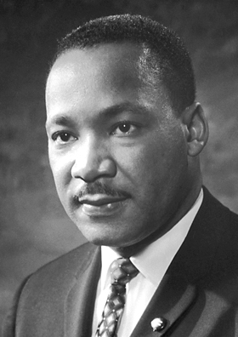
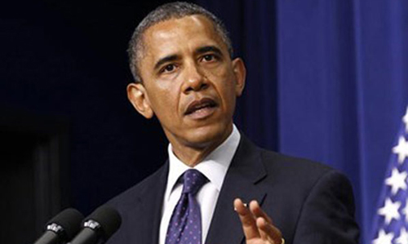
Theodore Parker
Look at the facts of the world. You see a continual and progressive triumph of [what is morally] right. I do not pretend to understand the moral universe, the arc is a long one, my eye reaches but little ways. I cannot calculate the curve and complete the figure by the experience of sight; I can divine it by conscience. But from what I see I am sure it bends towards justice
(Theodore Parker in May, 2013:100)

Slide 21
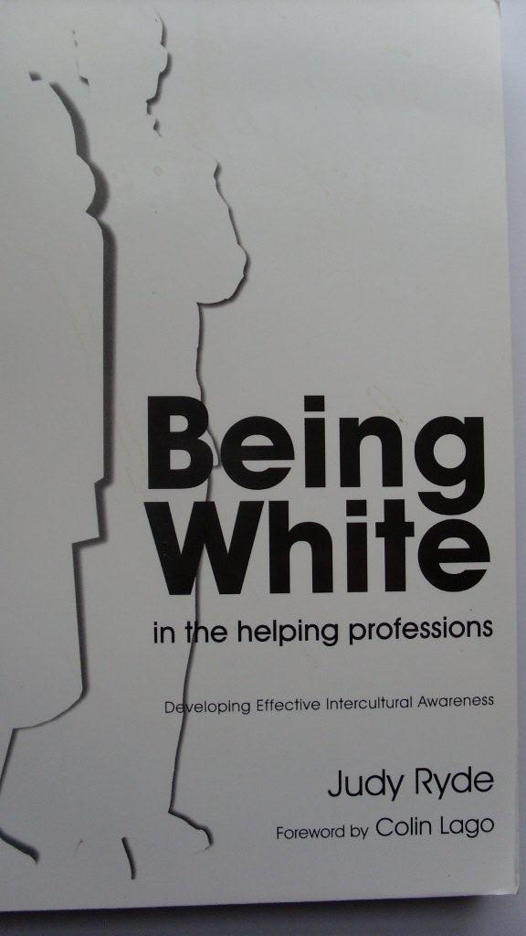
Books on white
privilege by Judy Ryde
Published by
Jessica Kingsley
Publishing

